Slide 1
Orlando’s Outlook: The Vote is In
Presented by
Philip J. Orlando, CFA Senior Vice President
Chief Equity Strategist
November 2022
Federated Advisory Services Company
22-10099 (11/22)

Slide 2
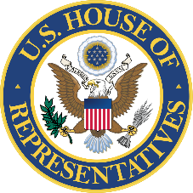
2022 Midterm Election
The most consequential in our lifetime
A record 42 million Americans voted early
41% of registered voters planned to vote early, up from 34% in the 2018 midterms
54% of Democrats voted early versus 32% of Republicans
Will voters re-institute a legislative check and balance?

Slide 3
It’s all About the Independent Voters Once Again
Party Affiliation Identification Gallup Poll
as of November 2020
Party Affiliation Identification Gallup Poll
as of November 2022
Latest polling data available from September 1-16, 2022.
Source: Gallup as of November 1, 2022.

Slide 4
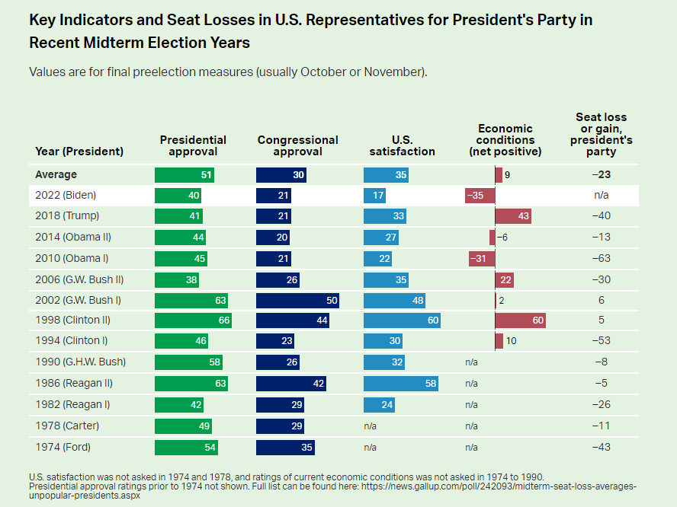
The public is not satisfied
U.S. satisfaction hits an all-time low this election year
Source: Gallup as of November 1, 2022.

Slide 5
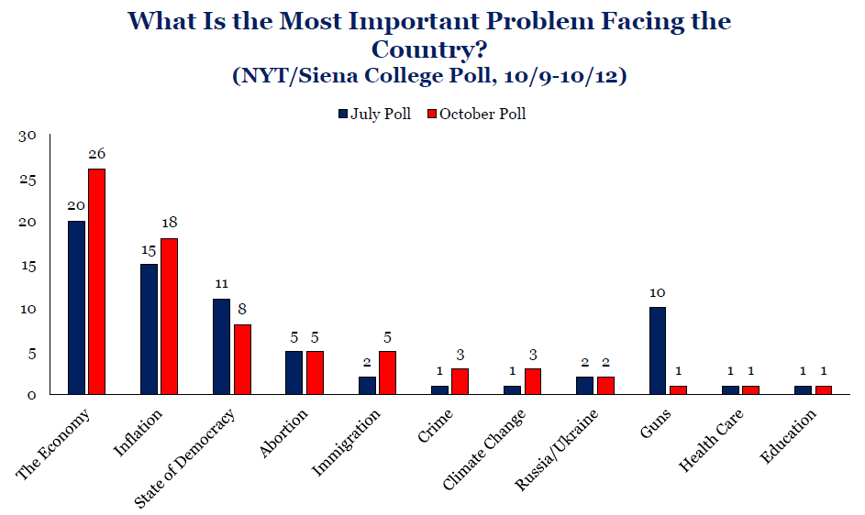
What are the voters most concerned about?
Source: Strategas Research Partners as of October 18, 2022.

Slide 6
Nominal CPI rose from 1.4% y/y in January 2021 to a 41-year high of 9.1% in June 2022
Consumer Price Index
(percent change at annual rate, quarterly)
9.1%
Jun 2022
8.3%
Sep 2022
3.6%
1Q83
Reagan
5.0%
1Q89
Bush I
1.9%
1Q09
Obama
3.0%
1Q01
Bush II
1.9%
1Q17
Trump
1.4%
Jan 2021
Biden
1.7%
1Q93
Clinton
Note: Shaded areas indicate recessions.
Source: FRED Economic Data as of November 8, 2022.

Slide 7
The recovery is complete: GDP output gap fully closed in 2Q21
The V-shaped recovery has transitioned to a new economic expansion
U.S. Real GDP (Chained $)
3Q22
20,021.7
Billion ($)
2Q21
19,368.3
4Q19
19,254.0
2Q20
17,258.2
Actual
Federated
Hermes Forecast
Source: Bloomberg & Federated Hermes. As of November 7, 2022.

Slide 8
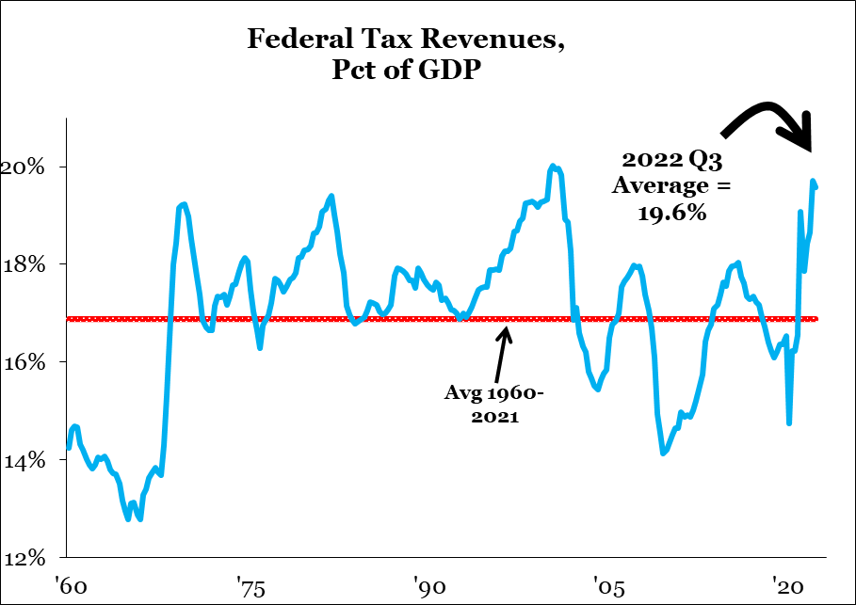
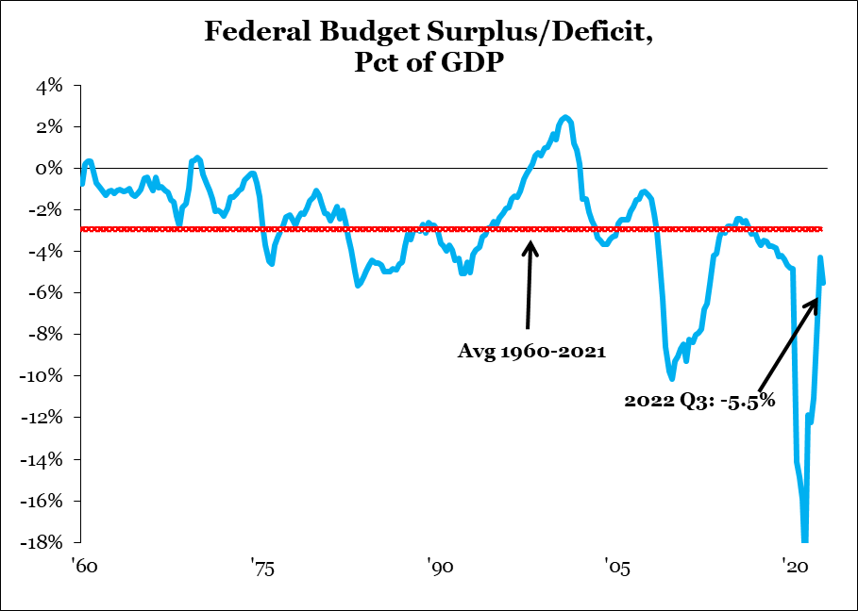
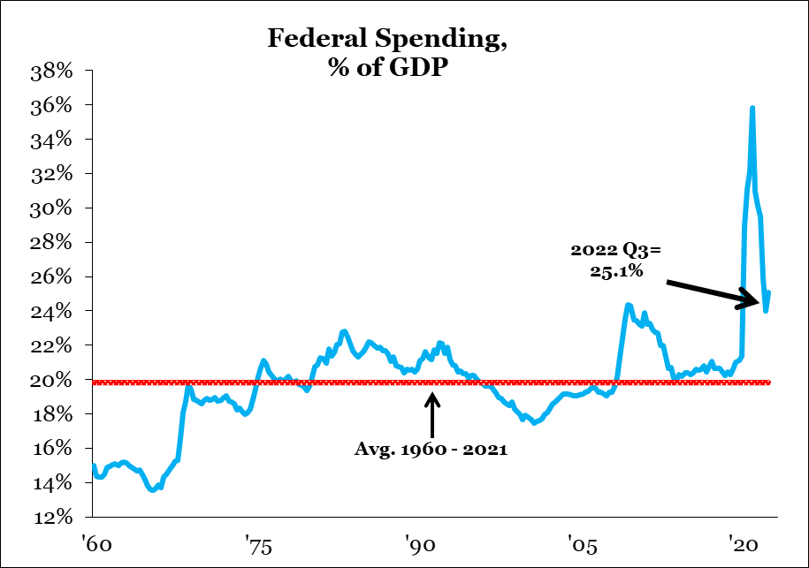
We have a spending problem, not a tax problem
Fiscal deficit driven by excessive spending, not a lack of tax revenues
Source: Strategas Research Partners, as of November 8, 2022.

Slide 9
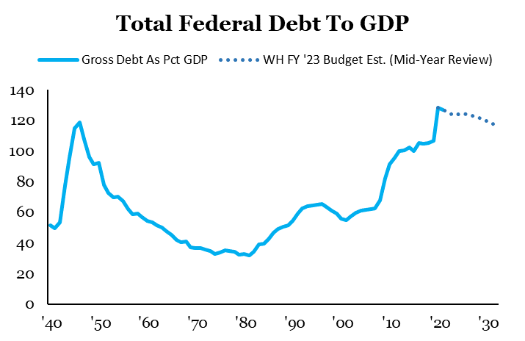
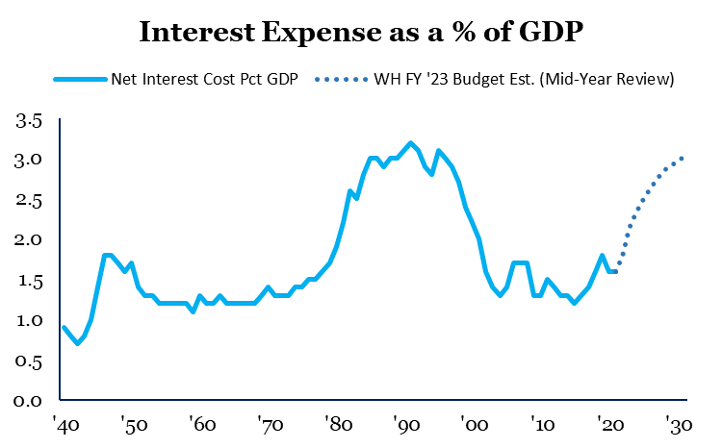
The total federal debt is a growing problem
While debt levels have risen sharply, low rates mean that the interest burden has fallen dramatically
Public Federal Debt (11/8/22) $22.5 trillion
Federal Reserve Balance Sheet (11/2/22) $8.7 trillion
Total Federal Debt (11/8/22) $31.2 trillion
Chained $ GDP (3Q22) $20.0 trillion
Total Debt/GDP Ratio 156%
Source: Strategas Research Partners, as of November 8, 2022. Federated Hermes as of November 8, 2022.

Slide 10
Fed’s first hike typically precedes next recession by several years
Fed Funds Rate: 4.00%
Avg. 4.8
Avg. 2.7
Note: Shaded areas indicate recessions. Fed Funds Rate refers to the upper band.
Source: FRED Economic Data as of November 7, 2022.

Slide 11
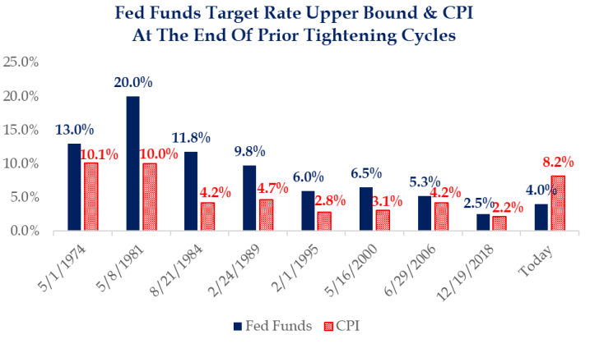
A primary prerequisite for Fed easing:
Positive real rates
Source: Strategas Research Partners as of November 7, 2022.

Slide 12
Inverted Yield Curve Typically Forecasts Recessions by 1-2 Years
10-Year Treasury Constant Maturity Minus Federal Funds Rate
10’s: 4.20%
-FF: 4.00%
YC: +0.20%
10’s = Benchmark 10yr Treasury Yield. FF = Fed Funds (upper limit). YC = Yield Curve. Shaded bars indicate recessions. Past performance is no guarantee of future results.
Source: FRED Economic Data as of November 7, 2022

Slide 13
Historical 2/10 spread an excellent precursor for impending recession
10-Year Treasury Constant Maturity Minus 2-Year Treasury Constant Maturity
Note: Shaded areas indicate recessions.
Source: FRED Economic Data as of November 7, 2022.

Slide 14
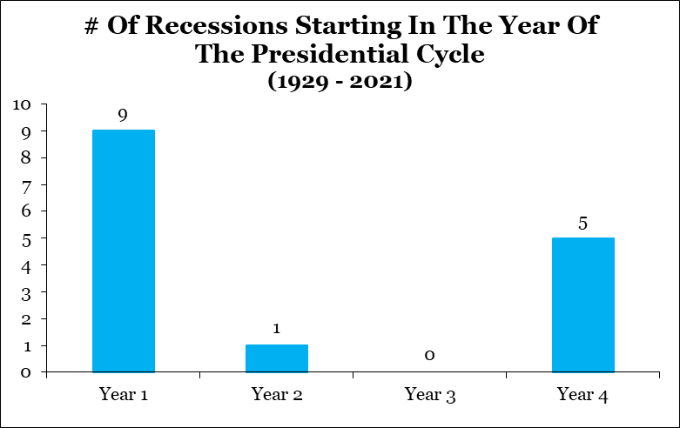
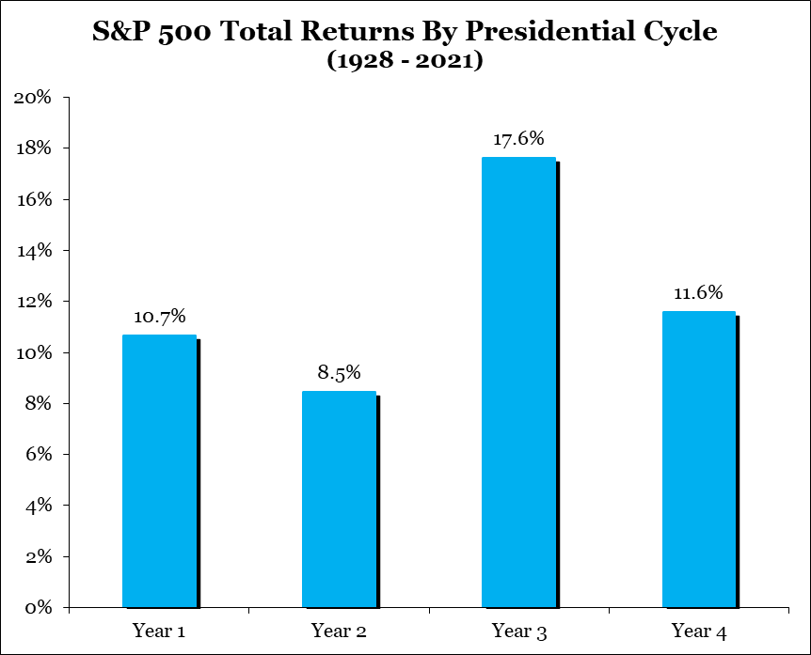
Political cycles are important for the economy and stocks:
Source: Strategas Research Partners as of September 28, 2022. Past performance is no guarantee of future results.
*Financial Crisis/Great Recession considered Jan 2008 (Year 4) start.

Slide 15
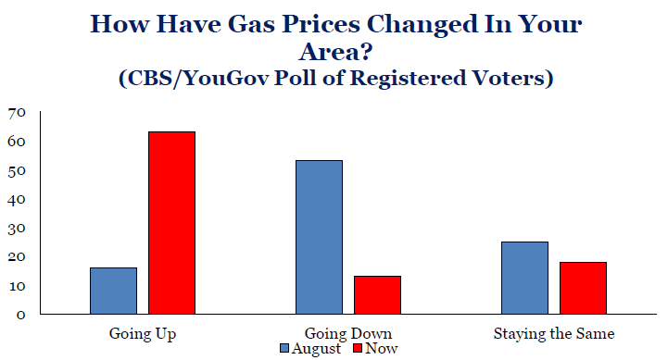
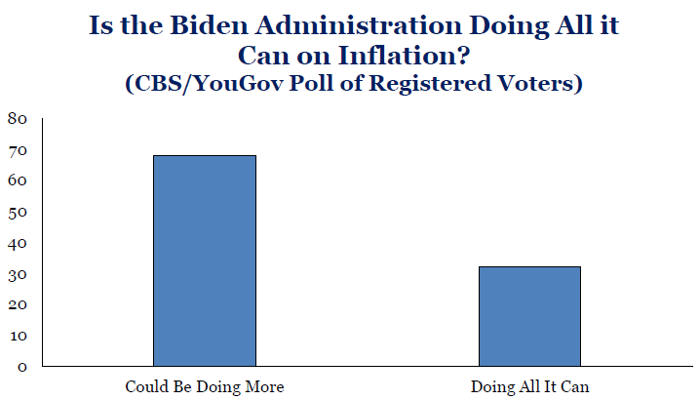
Voter perceptions on the major issues
Source: Strategas Research Partners as of October 18, 2022.

Slide 16
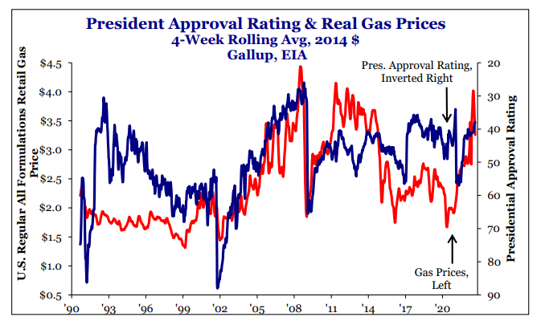
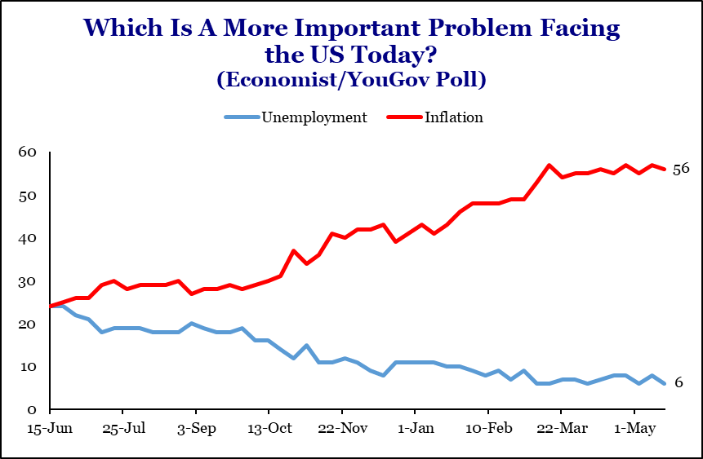
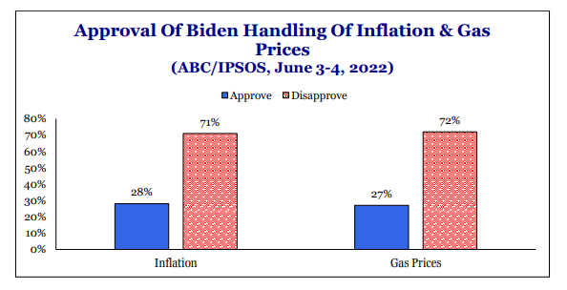
Inflation and the price of gasoline are major drivers of the presidential approval rating
Energy/GDP Leverage Rule of Thumb:
Every 1 cent change in the retail price of gasoline @ pumps = an inverse change of $1.18 billion in consumer discretionary spending
Daily nat’l avg. reg. unleaded gasoline price (Nov. 22, 2020) -- $2.11/gal (trough)
Daily nat’l avg. reg. unleaded gasoline price (June 13, 2022) -- $5.02/gal (peak)
Delta – 138% increase $2.91/gal
291 X $1.18 billion = $343.4 billion reduction in consumer discretionary spending
Divided by $19.7 trillion (2Q22 Chained $ GDP in U.S.) = 1.74% reduction in consumer spending
Divided by 70% (% of GDP for which consumer spending accounts) = 2.49% reduction in overall GDP annualized
Source: Strategas Research Partners, as of September 5 (left) May 17 (middle) and June 21, 2022 (right). American Automobile Association (AAA), Mike Rothman of Cornerstone Analytics and Federated Hermes as of August 1, 2022.

Slide 17
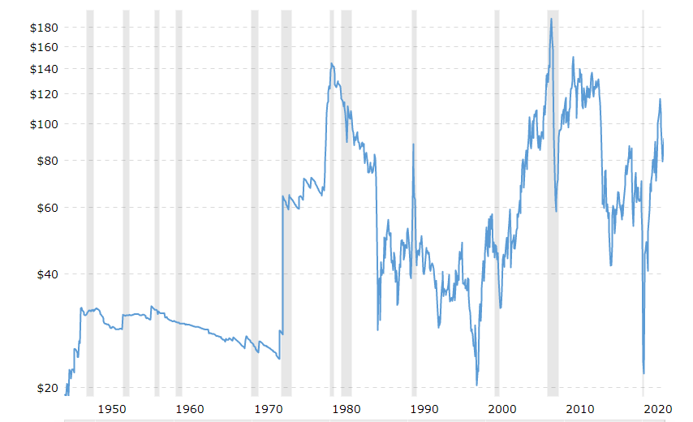
Strong historical correlation between oil price spikes and subsequent recessions
Note: Shaded areas indicate recessions.
Source: Macrotrends.net as of November 7, 2022.

Slide 18
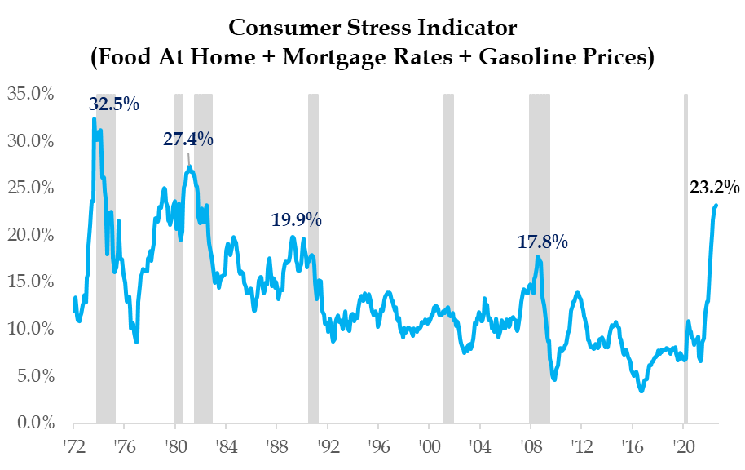
Consumer Stress Indicator
Consumers are feeling the strain of rising costs
Historically readings at the current levels have only come down after the economy dipped into a recession.
Shaded areas indicate recessions.
Source: Strategas Research Partners as of September 30, 2022.

Slide 19
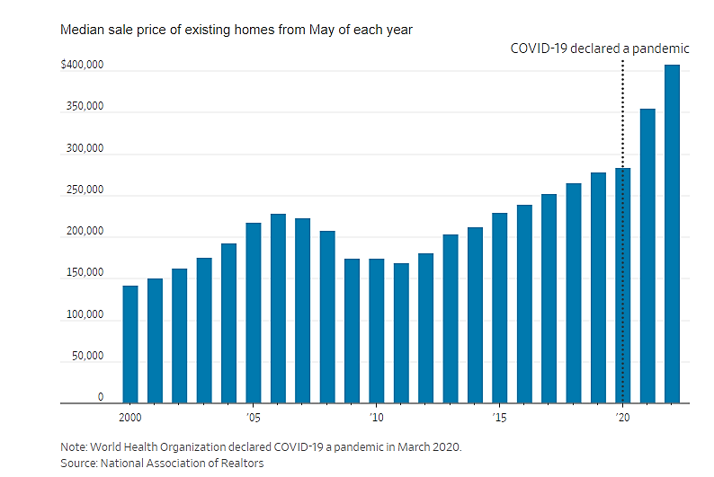
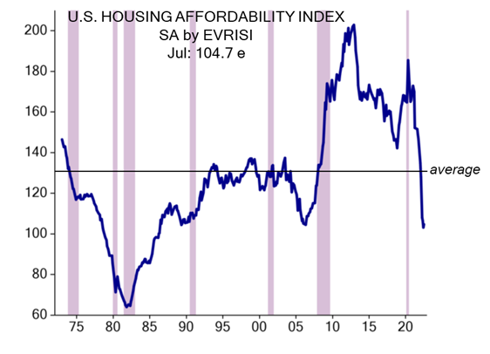
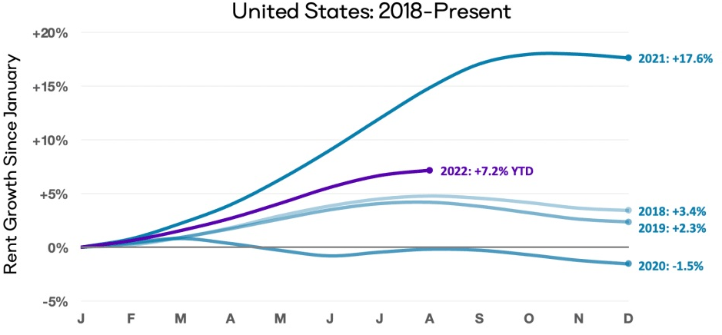
Housing Affordability Plummets
May was the most expensive month since 2006 to buy a home
Median Sale Price of Existing Homes from May of Each Year
United States Housing Affordability Index
Note: World Health Organization declared Covid-19 a pandemic in March 2020.
Source: National Association of Realtors as of July 2022.
Note: Higher values represent greater affordability.
Source: Evercore ISI as of September 9, 2022.
30-Year Fixed rate Mortgage Average in the United States
Annual Change in Median Rent
Source: FRED Economic Data as of September 8, 2022. Shaded bars indicate recessions
Source: Apartment List Rent Estimates as of August 30, 2022.
Shaded areas indicate recessions. Past performance is no guarantee of future results.

Slide 20
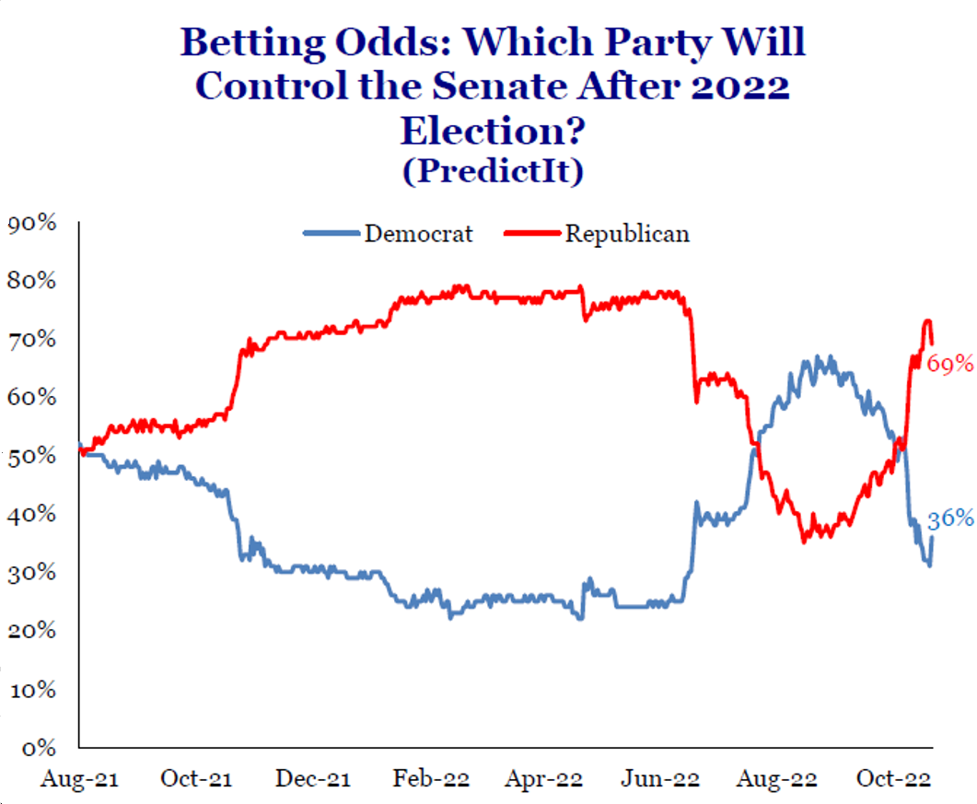
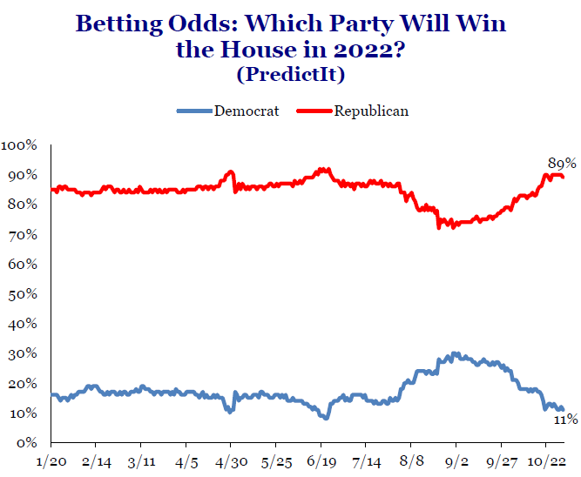
Odds have increased on a Republican sweep
Source: Strategas Research Partners as of November 1, 2022.

Slide 21
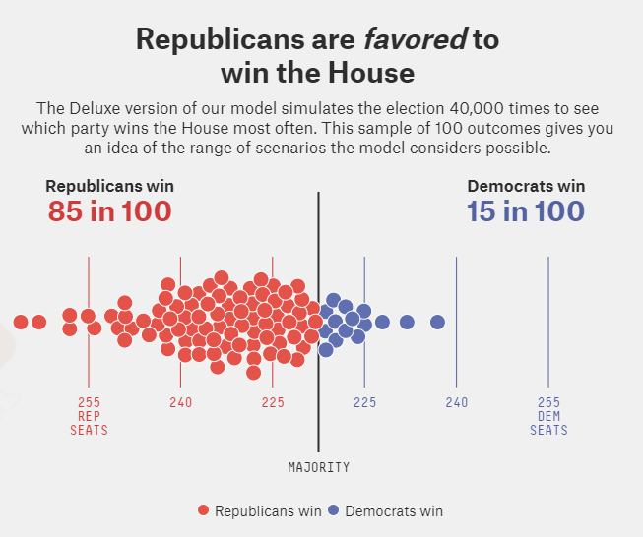
Republicans are favored to win the House
Following the Supreme Court’s decision to overturn Roe v. Wade, there appeared to be a real chance that Democrats could keep control of the House.
However, Republicans have regained much of the advantage that they had earlier this summer and now have a 4-in-5 chance of taking back control of the House.
Source: fivethirtyeight.com as of November 2, 2022.

Slide 22
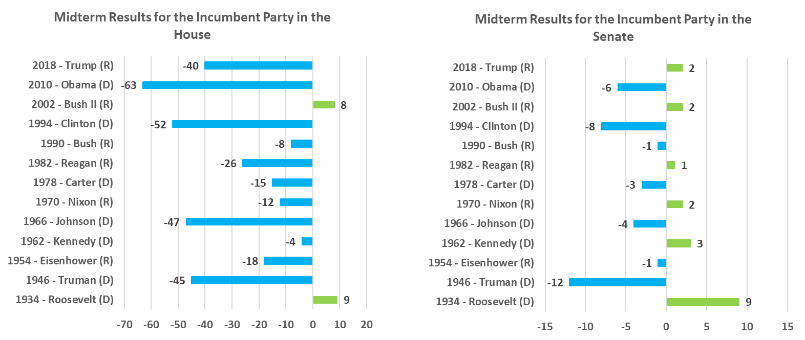
Congress could potentially flip in 2022
In the post-war era, the White House historically loses an average of 27 House seats and 2 Senate seats in the first midterm election. Democratic presidents lose an average of 38 House seats and 5 Senate seats.
NOTE: 33 Democratic members of Congress have already announced they are not seeking re-election, leaving those seats open for 2022.
Source: United States Historical Midterm Results from The American Presidency Project. As of July 12, 2022.

Slide 23
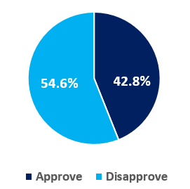
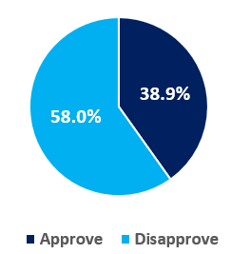
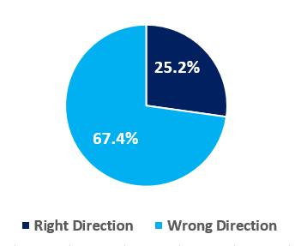
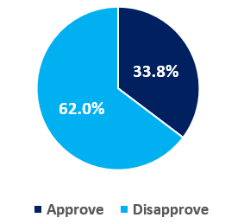
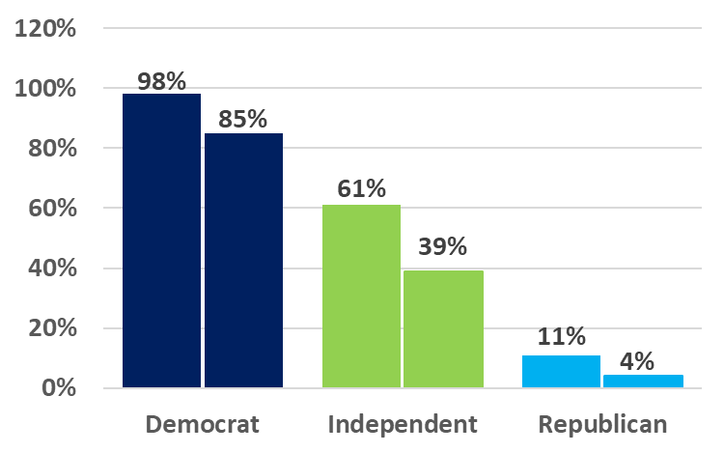
President Biden’s current approval ratings
Job Approval
The Economy
Inflation
Direction of the Country
15 %
Since
Jan 2021
Party Breakdown of Biden’s Approval Ratings
Recent Gallup polling has found that Independent party approval of President Biden has plunged 22 points since he took office.
Sources: Gallup as of October 25, 2022. RealClearPolitics as of November 2, 2022.

Slide 24
Republicans attempted to make the midterm election a “referendum” on these pocketbook and kitchen-table issues regarding President Biden:
Inflation soared from 1.4% in January 2021 to a 41-year high of 9.1% in June 2022:
Gas prices more than doubled from $2.11 to $5.02 per gallon
Food prices soaring
Shelter prices at record high, mortgage rates at 20-year high
Southern border with Mexico is a sieve
More than 2.8 million illegal immigrants entered U.S. in the last year
Violent crime is surging in major U.S. cities (NY, Chicago, San Francisco, etc.)
Democrats defund-the-police efforts and elimination of cash bail
Average daily COVID vaccination rate has plunged by 86% over the past 18 months
Standardized test scores for fourth and eighth graders have plummeted over the past two years, with schools shuttered in major cities
Baby formula shortage
Disastrous withdrawal from Afghanistan
15 American soldiers killed
Billions of dollars of military weapons abandoned for Taliban
Thousands of our Afghan allies left stranded
Iranian nuclear deal negotiations
Saudi Arabia oil negotiations and OPEC+ cutting 2 million BPD in production
Venezuela energy negotiations
Misguided U.S. energy policy and misuse of the Strategic Petroleum Reserve (SPR) for political reasons
Russia/Ukraine war

Slide 25
Democrats attempted to make the midterm election a “choice” between the social agendas of the Democrat versus the Republican parties:
Democrats brilliantly weaponized the Supreme Court’s Dobbs decision on Roe v. Wade, in which SCOTUS returned the Constitutional right to an abortion back to the individual states for the first time in nearly a half century.
Democrats elevated former President Trump as an ongoing and existential “threat to democracy” by:
1. Broadcasting a dozen January 6th Capitol insurrection hearings in prime time
2. Publicizing the FBI document raid on former President Trump’s home in Mar-a-Lago
Using Hurricane Ian’s tragic destruction and loss of life in southwest Florida as an example of the growing climate-change crisis.

Slide 26
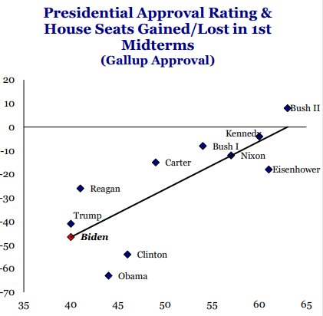
Historical mid-term trends by presidential approval rating
Number of seats gained and lost in the House
Source: Strategas Research Partners, as of November 3, 2022.

Slide 27
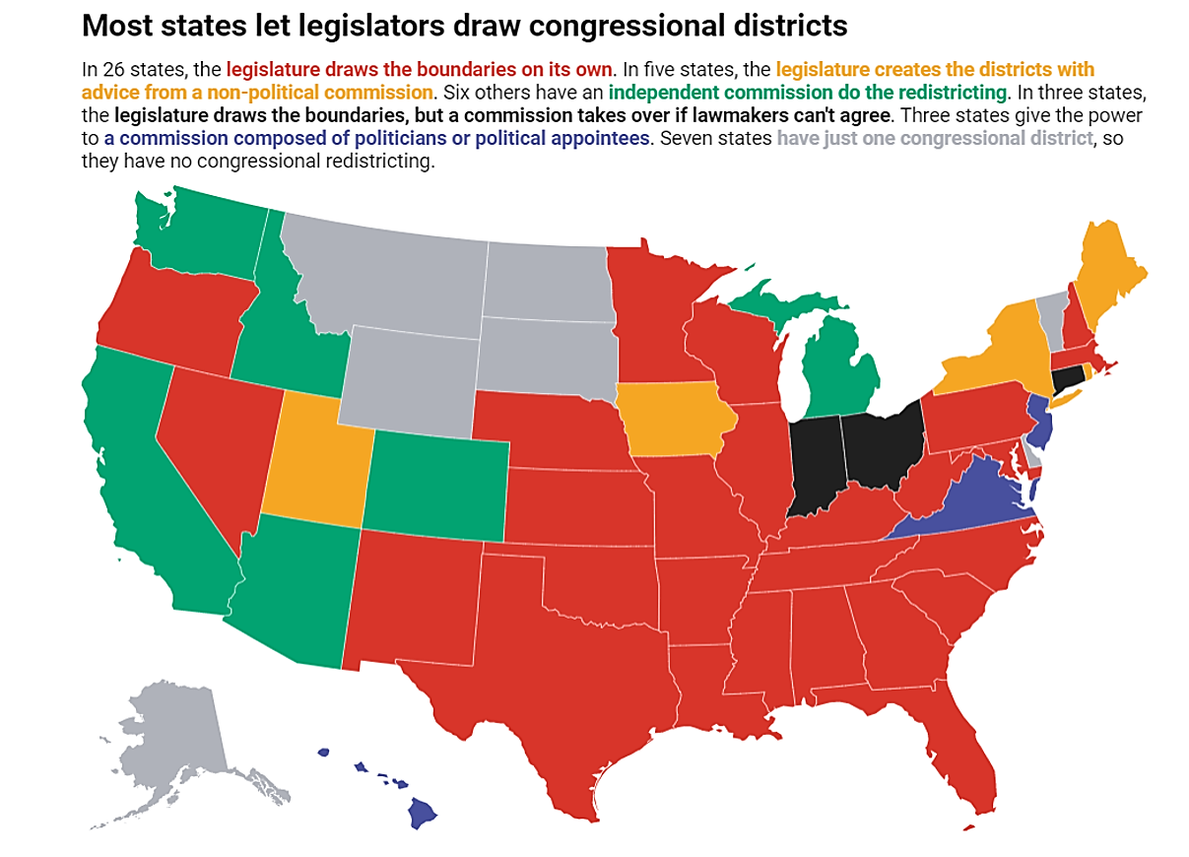
Congressional redistricting from the 2020 decennial census favors Republicans, but subsequent Democratic gerrymandering blunts their net gain
Population migration from high-tax to low- or no-tax states over the past decade:
Californians migrating to Nevada and Arizona
Illinois residents moving to Texas
New York, New Jersey, Connecticut and Massachusetts residents moving to Tennessee, North Carolina, South Carolina and Florida
Republicans gained six net seats – less than the 10-15 net-seat gain that had been expected – in the House of Representatives in the 2022 midterm elections, due exclusively to the Census and the subsequent Congressional redistricting of its 435 seats.
But President Biden signed an executive order in January 2021, undoing President Trump’s order to keep undocumented immigrants from being included in the state-by-state Census tallies. This resulted in a population shift of an estimated 3 million people (1% of 331 million U.S. residents) from Republican to Democratic states, which prevented an additional six seats from shifting from Democratic states to Republican states.
The Democrats state-by-state gerrymandering process has resulted in an estimated net pickup of 4-5 seats.
Note: Some states use different procedures for drawing state legislative district boundaries.
Map: The Conversation, CC-BY-ND Source: Robin Best and Steve Lem
Source: The Conversation.com as of November 24, 2020 and Federated Hermes as of April 2022.

Slide 28
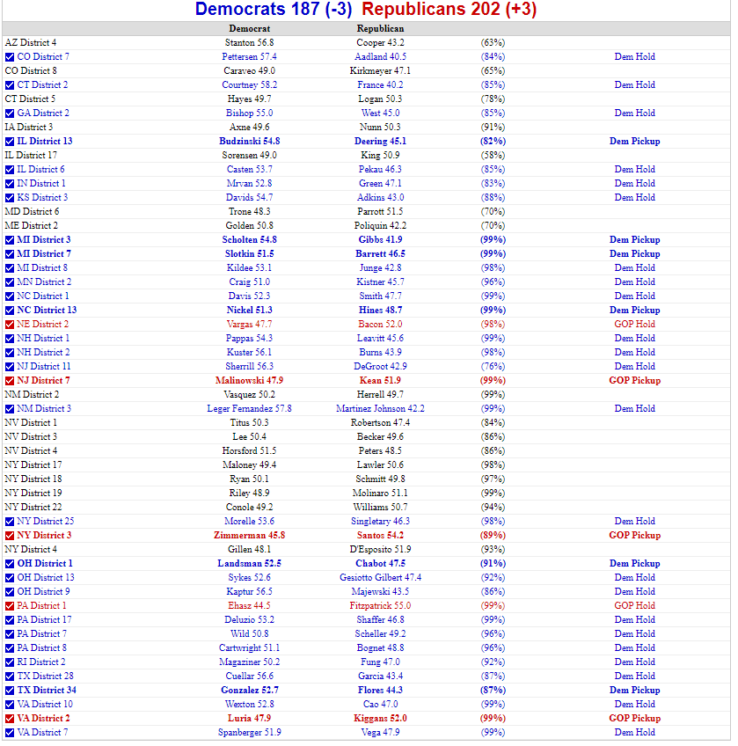
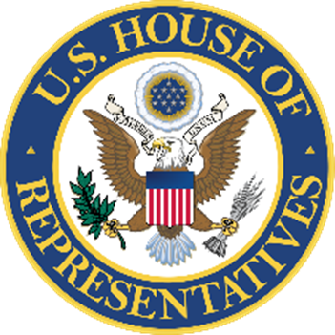
2022 Midterm Election: The House
Pre-election House:
221 Democrats – 212 Republicans
2 open seats
Current House (as of 11/9/22):
183 Democrats (-3) – 202 Republicans (+3)
Current Undecided Seats:
50
Source: RealClear Politics as of November 9, 2020.

Slide 29
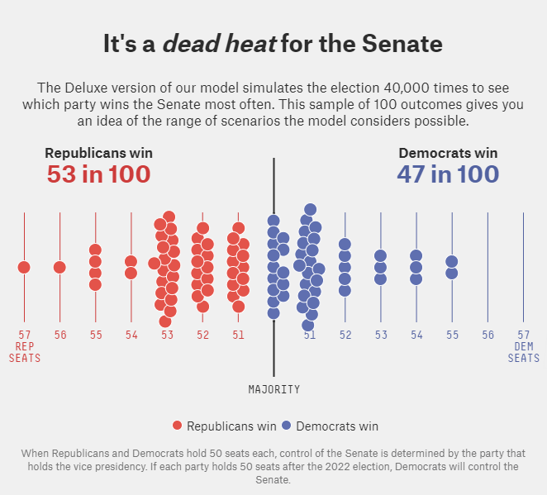
The Senate is currently a toss-up
The party that wins two of the three closest states will likely win the Senate majority
The Republican’s two best pick-up opportunities are Nevada and Georgia.
Democrats are hoping to pick up Pennsylvania, but that race has recently gotten a lot tighter.
Democratic incumbents currently have an edge in Arizona and New Hampshire, while the Senate races in North Carolina, Ohio and Wisconsin will likely result in Republican winners.
Source: fivethirtyeight.com as of November 2, 2022.

Slide 30
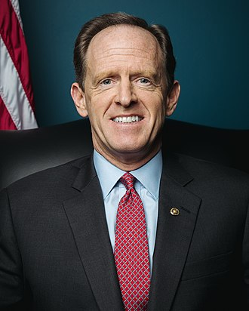
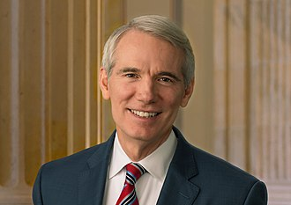
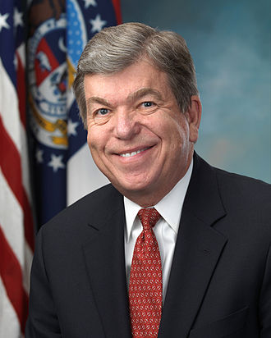
Democrats could establish an outright Senate lead in the 2022 mid-term election, but demographics favor Republicans in 2024
Current Senate: 50 Republicans – 50 Democrats
In the November 2022 midterms, 35 seats are up for election:
Republicans defending 21 seats, but Democrats only defending 14 seats.
Republican Senate retirements for 2022 already announced:
Senator (PA)
Pat Toomey
Senator (OH)
Rob Portman
Senator (NC)
Richard Burr
Senator (AL)
Richard Shelby
Senator (MO)
Roy Blunt
Conclusion: it is much easier for the Democrats to win and re-claim an open seat than an incumbent seat.
In the November 2024 presidential election, 33 seats are up for election:
Republicans defending only 10 seats, but Democrats defending 23 seats.
Source: Federated Hermes

Slide 31
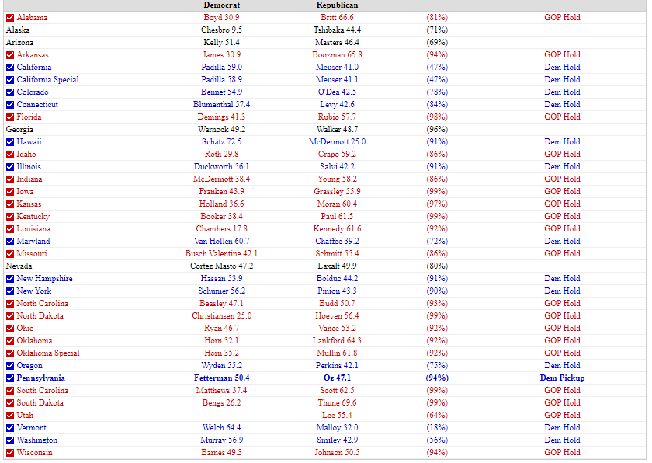
2022 Midterm Election: The Senate
Pre-election Senate:
50 Democrats – 50 Republicans
Current Senate (as of 11/9/22):
48 Democrats (+1) – 48 Republicans (-1)
Current Undecided Seats:
4
Source: RealClear Politics as of November 9, 2020.

Slide 32
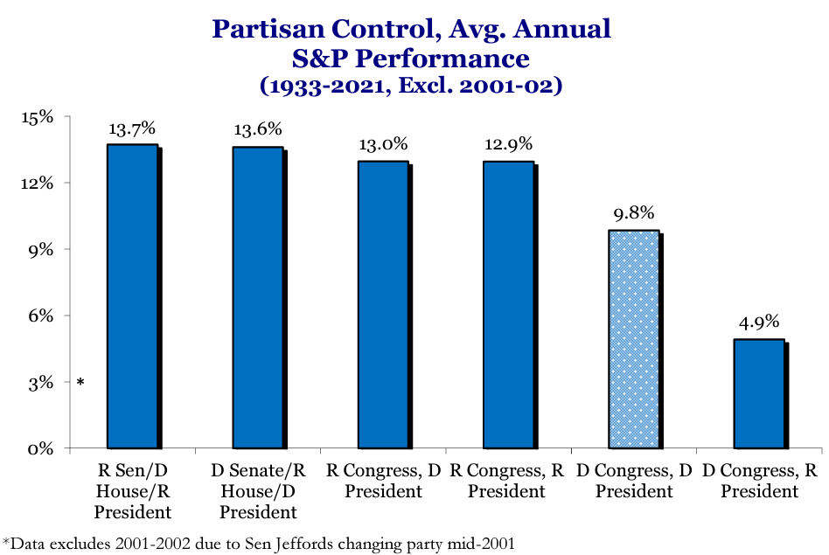
The Power of the Purse: Control of Congress Matters Most for Stocks
*
Source: Strategas Research Partners as of October 2022. Past performance is no guarantee of future results.

Slide 33
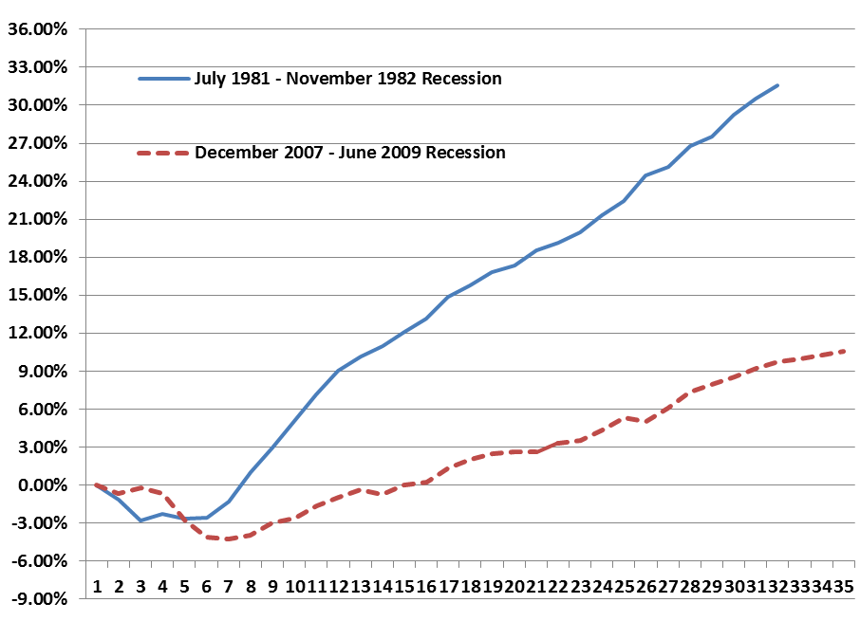
Fiscal Policy Matters – The “Zarnowitz Rule”
Inherited Quarterly
GDP Trough
GDP cumulative change from the end of the recession
Reagan | Obama
2Q80 (7.9%) | 4Q08 (8.2%)
Reagan Recovery
After Deep Recessions
Quarterly GDP growth, seasonally adjusted on an annual basis
Obama Recovery
Reagan | Obama
4Q82 0.4% | 3Q09 1.3%
1Q83 5.3% | 4Q09 3.9%
2Q83 9.4% | 1Q10 1.7%
3Q83 8.1% | 2Q10 3.9%
4Q83 8.5% | 3Q10 2.7%
1Q84 8.2% | 4Q10 2.5%
2Q84 7.2% | 1Q11 (1.5)%
3Q84 4.0% | 2Q11 2.9%
4Q84 3.2% | 3Q11 0.8%
1Q85 4.0% | 4Q11 4.6%
2Q85 3.7% | 1Q12 2.7%
3Q85 6.4% | 2Q12 1.9%
4Q85 3.0% | 3Q12 0.5%
1Q86 3.8% 2Q86 1.9% | 4Q12 0.1% 1Q13 2.8%
3Q86 4.1% | 2Q13 0.8%
4Q86 2.1% | 3Q13 3.1%
1Q87 2.8% | 4Q13 4.0%
2Q87 4.6% | 1Q14 (1.2)%
3Q87 3.7% | 2Q14 4.0%
4Q87 6.8% | 3Q14 5.0%
1Q88 2.3% | 4Q14 2.3%
2Q88 5.4% | 1Q15 2.0%
3Q88 2.3% | 2Q15 2.6%
4Q88 5.4% | 3Q15 2.0%
1Q89 4.1% | 4Q15 0.9%
2Q89 3.2% | 1Q16 0.8%
3Q89 3.0% | 2Q16 1.4%
4.5% Annual Run GDP Rate
2.1% Annual Run GDP Rate
Quarters after each recession start
Source: Wall Street Journal and Commerce Department, National Bureau of Economic Research, as of October 10, 2016.

Slide 34
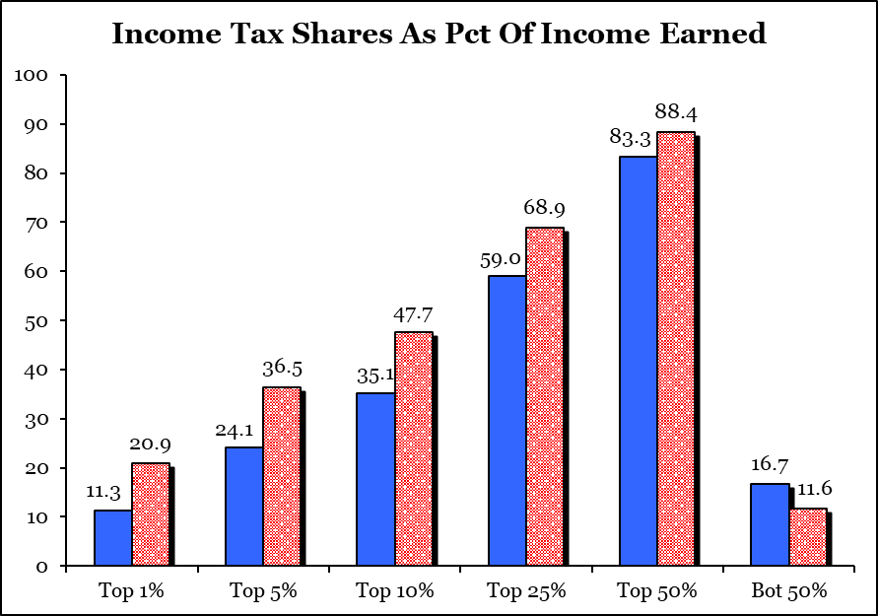
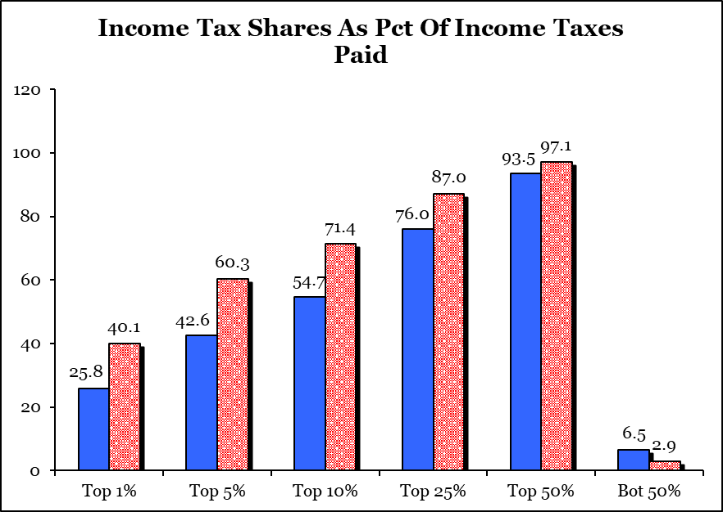
Higher Earners Already Paying a Progressively Larger Share of the Federal Tax Burden
The “rich” are certainly getting richer…
1986
2018
+ 12.6%
+ 12.4%
+ 9.6%
- 5.1%
1986
2018
+ 16.7%
+ 17.7%
2018 Income
greater than:
+ 14.3%
$540K
$218K
$152K
$87K
$44K
$0K
- 3.6%
…but they are also paying a proportionately larger share of federal taxes
Source: IRS, Strategas, as of December 2020.
2018 Income
greater than:
$540K
$218K
$152K
$87K
$44K
$0K

Slide 35
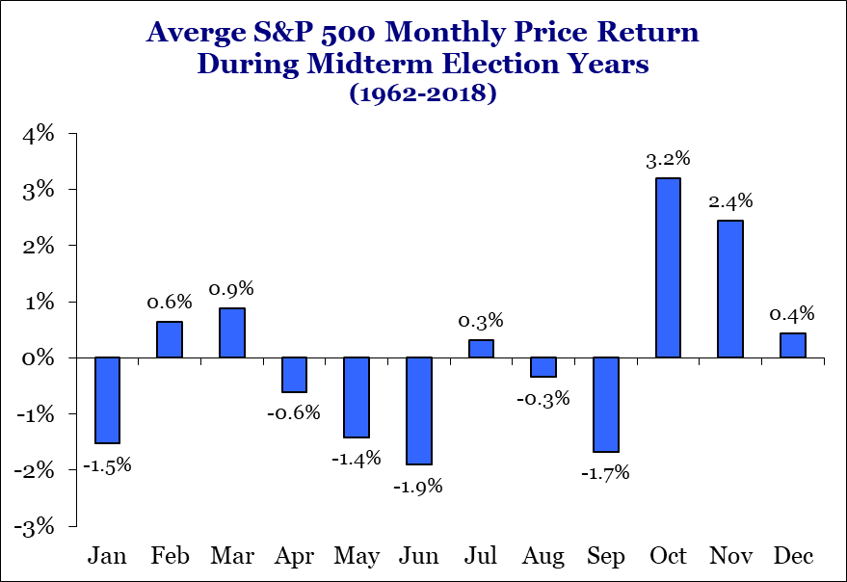
Presidential election cycle downside risk elevates during year two
S&P 500 Returns In The Presidential Cycle Data: 12/31/44 - 12/31/2021
Year Of Presidential Cycle | Average S&P 500 Price Return Since 1945
 | Q1 | Q2 | Q3 | Q4 | Year
Year 1 | 0.2% | 2.8% | 1.2% | 4.2% | 9.2%
Year 2 | 1.1% | -1.8% | -0.6% | 6.4% | 5.0%
Year 3 | 7.0% | 4.6% | 0.6% | 3.4% | 15.9%
Year 4 | 0.1% | 3.3% | 0.9% | 2.3% | 6.9%
All Years | 2.0% | 2.2% | 0.5% | 4.0% | 9.2%
Source: Strategas as of January 20, 2022. Past performance is no guarantee of future results.

Slide 36
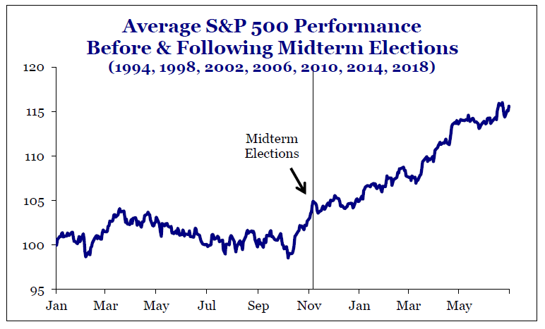
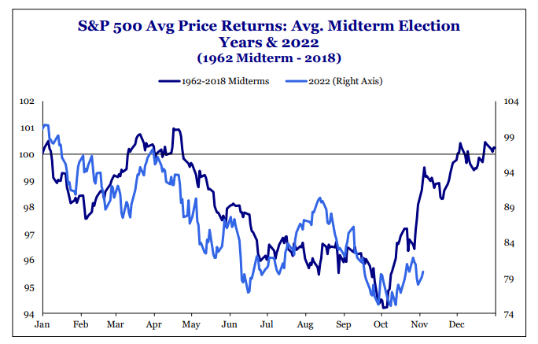
Average midterm election year correction is a buying opportunity
Source: Strategas Research Partners, as of November 8, 2022.

Slide 37
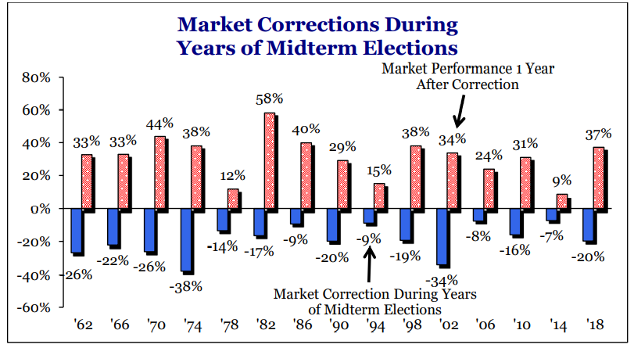
Average mid-term election year maximum drawdown is 19% for the S&P 500, followed by 31% rally in the following year
Source: Strategas Research Partners, as of December 9, 2021. Past performance is no guarantee of future results.

Slide 38
GDP: Unprecedented V-shaped recovery
Views are as of October 27, 2022
 | 1Q | 2Q | 3Q | 4Q | FY
2007 | 1.2 | 2.6 | 2.4 | 2.5 | 2.0
2008 | (1.6) | 2.3 | (2.1) | (8.5) | (0.1)
2009 | (4.6)* | (0.7)* | 1.5 | 4.3 | (2.6)
2010 | 2.0 | 3.9 | 3.1 | 2.1 | 2.7
2011 | (1.0) | 2.7 | (0.2) | 4.6 | 1.5
2012 | 3.3 | 1.8 | 0.7 | 0.4 | 2.3
2013 | 3.5 | 0.6 | 3.2 | 2.9 | 1.8
2014 | (1.4) | 5.2 | 4.7 | 1.8 | 2.3
2015 | 3.3 | 2.3 | 1.3 | 0.6 | 2.7
2016 | 2.4 | 1.2 | 2.4 | 2.0 | 1.7
2017 | 1.7 | 2.0 | 3.4 | 4.1 | 2.2
2018 | 2.8 | 2.8 | 2.9 | 0.7 | 2.9
2019 | 2.2 | 2.7 | 3.6 | 1.8 | 2.3
2020 | (4.6) | (29.9)** | 35.3 | 3.9 | (2.8)
2021 | 6.3A | 7.0A | 2.7A | 7.0A | 5.9A
2022 | (1.6)A | (0.6)A | 2.6A | 0.1E | 1.6E
2023 | (0.7)E | (1.2)E | (0.6)E | (0.6)E | (0.4)E
Note: *Great Recession ended June 2009. **Pandemic Recession ended April 2020.
Source: The Commerce Department as of September 2022 and includes benchmark revisions recently made.

Slide 39
Federated Hermes forecast
Views are as of November 8, 2022
 | 2016A | 2017A | 2018A | 2019A | 2020A | 2021A | 2022E | 2023E | 2024E
Real GDP | 1.70% | 2.30% | 3.00% | 2.20% | (3.50)% | 5.90% | 1.60% | (0.40)% | N/A
Core CPI | 2.20% | 1.80% | 2.20% | 2.30% | 1.60% | 5.50% | 5.70% | 4.10% | 3.00%
Core PCE | 1.80% | 1.60% | 2.00% | 1.60% | 1.50% | 4.90% | 5.00% | 3.60% | 2.50%
Benchmark 10yr Treasury Yield | 2.50% | 2.40% | 2.68% | 1.92% | 0.92% | 1.51% | 4.25% | 3.25% | 3.00%
Fed Funds Rate (upper band) | 0.75% | 1.50% | 2.50% | 1.75% | 0.25% | 0.25% | 4.50% | 5.00% | 4.00%
S&P 500 EPS | $119 | $133 | $163 | $167 | $137 | $209 | $220 | $230 | $250
Target Forward P/E | 16.8x | 16.4x | 15.0x | 23.6x | 18.0x | 21.7x | 17.0x | 16.0x | N/A
S&P 500 Target Price | 2,239 | 2,674 | 2,507 | 3,231 | 3,756 | 4,766 | 3,900 | 4,000 | N/A
PCE = Personal Consumption Expenditures. 2016, 2017, 2018, 2019, 2020 and 2021 are actual.
Views are as of the date indicated and are subject to change based on market conditions and other factors. These views should not be construed as a recommendation for any specific security or sector.
Source: Federated Hermes and the Commerce Department.

Slide 40
Federated Hermes investment focus
Views are as of November 8, 2022
Recommended % Allocation
Recommended Sector Allocation
Equity – 1% Underweight
Bonds – 7% Underweight
Cash – 7% Overweight
Fixed Income Duration – 100%
Overweight
Energy
Health Care
Staples
Utilities
Neutral
Industrials
REITs
Financials
Materials
Underweight
Comm. Services
Discretionary
Technology
Asset Allocation Matrix
Equities
Bonds
Overweight
U.S. Small Cap Value
U.S. Large Cap Value
Neutral
Emerging Markets
International Developed
International Small-Mid Cap
Underweight
U.S. Large Cap Growth
U.S. Small Cap Growth
Overweight
Agencies
Emerging Markets
MBS
Treasuries
Neutral
Muni’s
TIPs
Underweight
CMBS
High Yield
IG Corporates
International Developed
The information and data contained herein are provided solely for informational purposes. Accordingly, this communications does not represent specific investment advice and should not be construed as an investment recommendation.

Slide 41
2022 Midterm Election Conclusions
Modest Republican victory in the House, not the hoped-for Red Tsunami
Coin flip for control of the Senate, unlikely to be decided before Georgia run-off on December 6.
Financial markets have already rendered their assessment of the efficacy of the Biden Administration’s fiscal policies in 2022:
1. SPX plunged by 27.5% from January 4 peak to October 13 trough
2. Benchmark 10-year Treasury yields have soared from 1.50% in January to 4.25% in November
3. Two-year Treasury yields have surged from 0.75% in January to 4.80% in November
4. Inversion of 55 basis points between two- and 10-year Treasury yields implies growing risk of recession over the next two years
SPX rally of 12% from October 13 into election day was an overly optimistic assessment of a Republican sweep, the prospect of divided government and a successful legislative check-and-balance on the Biden Administration’s fiscal policies.
Although he outperformed his low approval rating, President Biden has at least lost the House, which means that his legislative agenda is dead. Democrats may look for new, younger leadership in 2024.
Due to poor electoral performances for Dr. Oz in PA, Blake Masters in AZ, and Hershel Walker in GA., among others, voters rejected former President Trump and his influence with these hand-picked candidates, limiting his chances to successfully run again in 2024.
Ron DeSantis enjoyed a powerful re-election bid as Florida’s governor, establishing himself as the early front runner for Republicans in 2024.

Slide 42
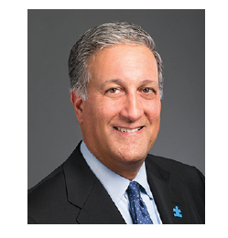
Biography
Phil Orlando is Federated Hermes’ chief equity strategist and the head of the Client Portfolio Management team. He joined Federated in 2003 and, with more than 40 years of industry experience, Phil is responsible for the formulation of Federated Hermes’ views on the economy, the financial markets and the firm’s positioning strategies.
He serves as the chairman of both the Macro Economic Policy and the PRISM Asset Allocation committees. As the head of the Client Portfolio Management team, Phil is responsible for bringing extensive macroeconomic, investment strategy and product knowledge directly to clients in collaboration with the sales team.
Throughout his career, Phil has been recognized for his ability to accurately synthesize the interrelationship among highly complex financial, economic and political market developments, and translate them into easily understandable concepts. He is a popular keynote speaker, addressing many national investment conferences.
For more than 25 years, Phil has been a regular contributor to the financial media, including CNBC, Bloomberg, Fox Business News, Reuters, The Wall Street Journal and The New York Times, among many other media outlets.
Phil received his bachelor’s degree and MBA from New York University. He is a CFA® charterholder.
Phil is married and has three children. While he spends much of his time off with his family, he is also very active in charity work. He is on the Board of Directors of two Westchester-based charities that work with special-needs children: The Foundation for Empowering Citizens with Autism (FECA) and Extraordinary Ventures New York (EVNY). He is also an advisory-board member of the Cancer Support Team (CST).
Philip Orlando, CFA
Chief Equity Market Strategist
Head of Client Portfolio Management
Senior Vice President
42
Years of Industry Experience

Slide 43
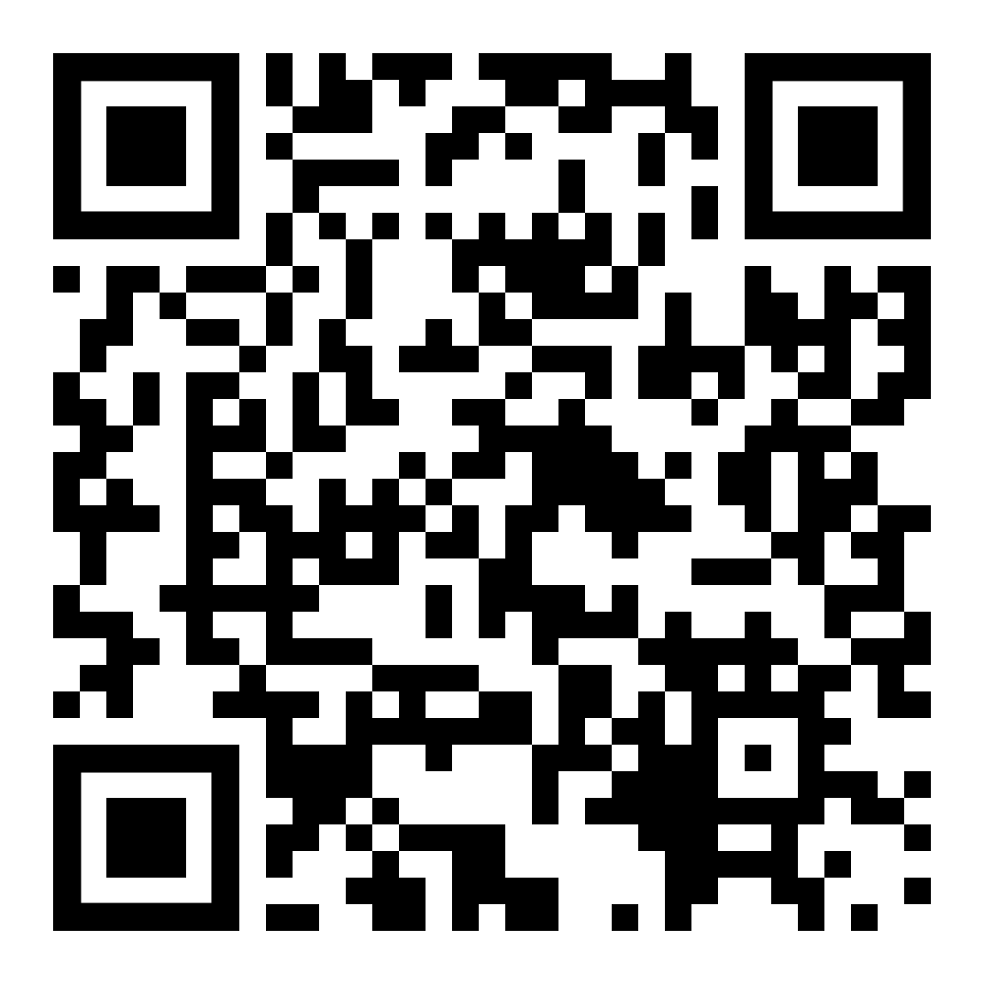
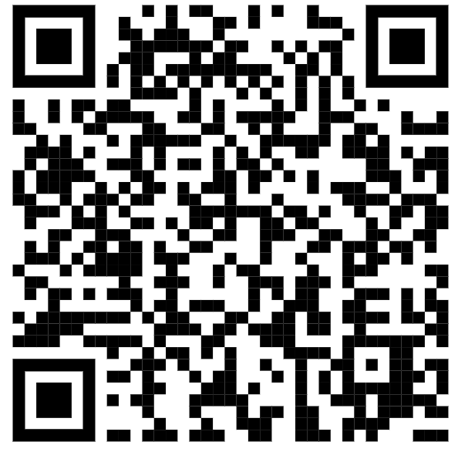
Interested in hearing more?
Scan the QR codes for additional information
Website resources
FederatedInvestors.com/PhilOrlando
Join next webcast
Equity and Fixed Income Update
Sign up for email updates
Watch YouTube videos
Connect on LinkedIn
Attend next quarterly webcast
December 1,2022 at 3 p.m. ET
Featuring Phil Orlando, RJ Gallo, hosted by Linda Duessel

